Slide 1
How Do I
Apply to school?

Slide 2
agenda
Introduction
Application Process
What To Look For
How To Get Your Child Ready
Final Tips & Takeaways

Slide 3

Applying to school

Slide 4
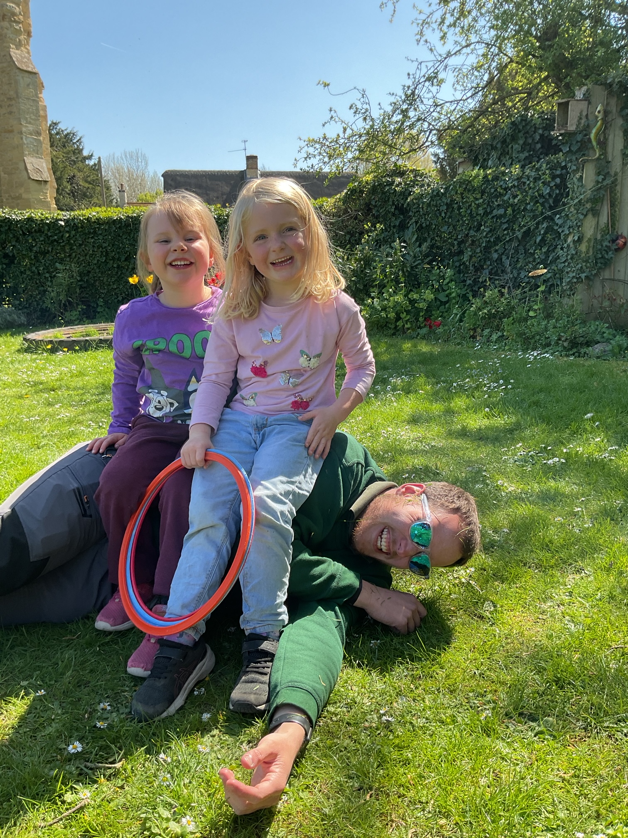
Exceptions
Independent Schools
Children with EHCPs (SEN)
Applying across county borders
These work slightly differently.
Have a chat with us at the end if you
have any questions about applying to
these.

Slide 5
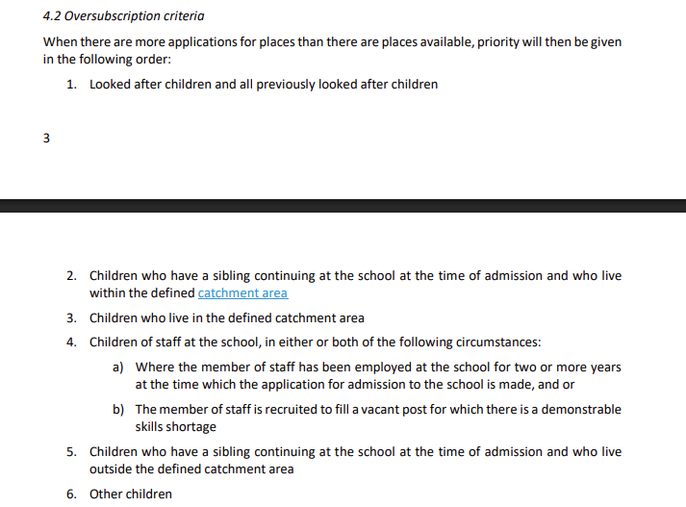
The application process
All online (accessible copies available through Admissions)
Up to 6 options
You are able to provide information to support your application
Lists of selection criteria are available on school websites:
Tip: for academies, look at their admissions policy. For maintained schools, check out local authority guidance.

Slide 6
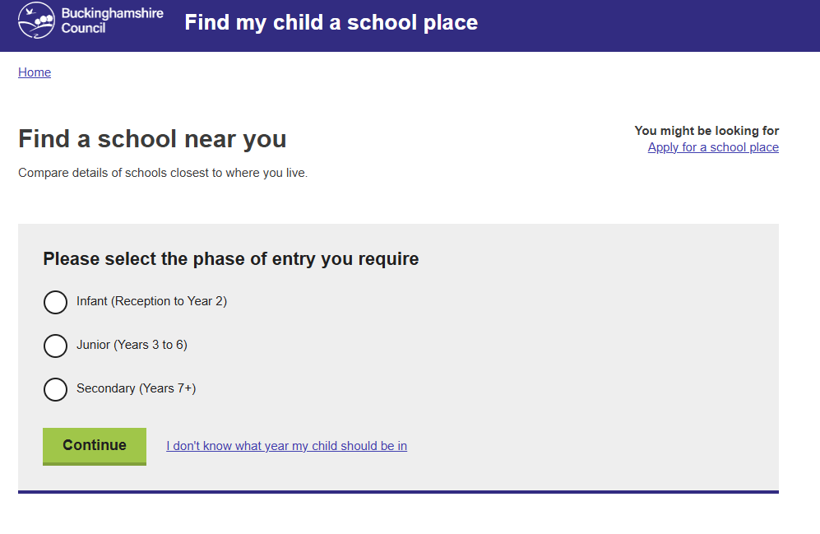
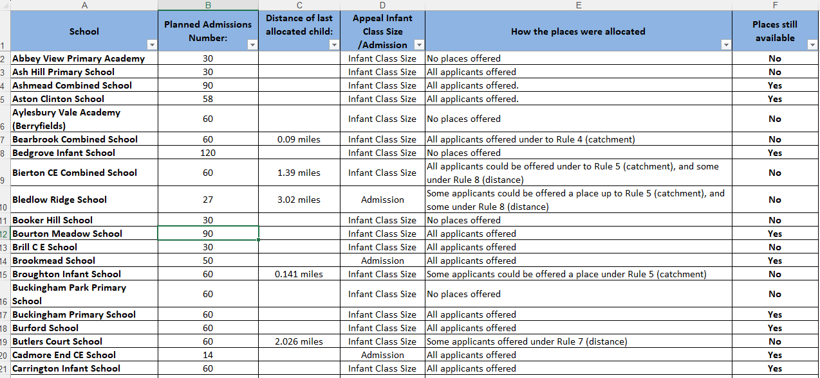
Information available:
https://schools.buckinghamshire.gov.uk/school-admissions/nearest
https://www.buckinghamshire.gov.uk/schools-libraries-and-parks/school-admissions-and-appeals/guides-and-policies/school-place-allocation-statistics/

Slide 7
An example
Tom has three preferences.
His parent lists them as:
1. High Town School
2. Leafy Lane School
3. Long Avenue School

Slide 8
Step one

Slide 9
Step two

Slide 10
Step three

Slide 11
Step four

Slide 12
Step five

Slide 13
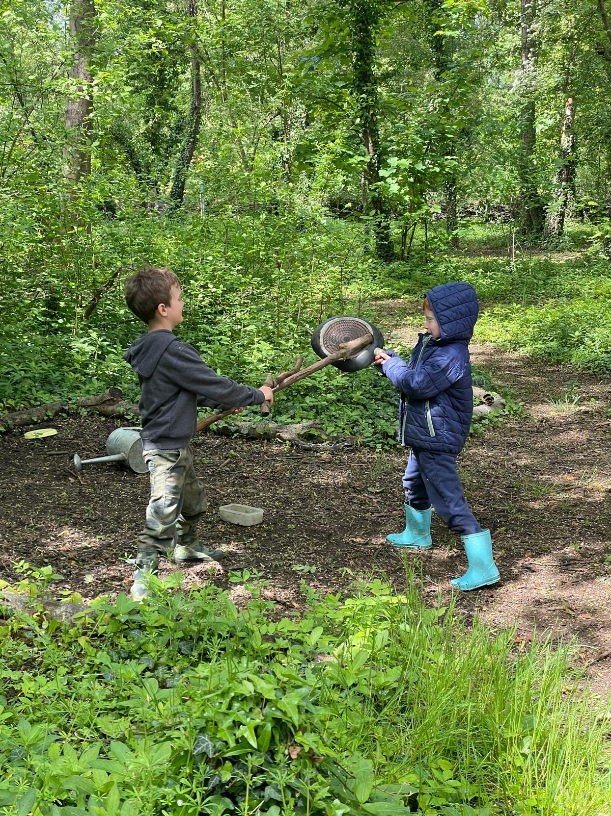
Waiting lists
Waiting lists are automatic
You’ll be offered a place at a higher choice school,
if one comes up
Let admissions know if you don’t want to be on
a waiting list any longer

Slide 14
tips
Make a note of which email address you used
Set up an account – you’ll get reminders to apply
Include your catchment school somewhere on the list
If you have a sibling at the school, include this information
Need your council tax number
Think about how you will get your child there. Transport is provided to the nearest primary school if it is over 2 miles away.
Ask the question!

Slide 15
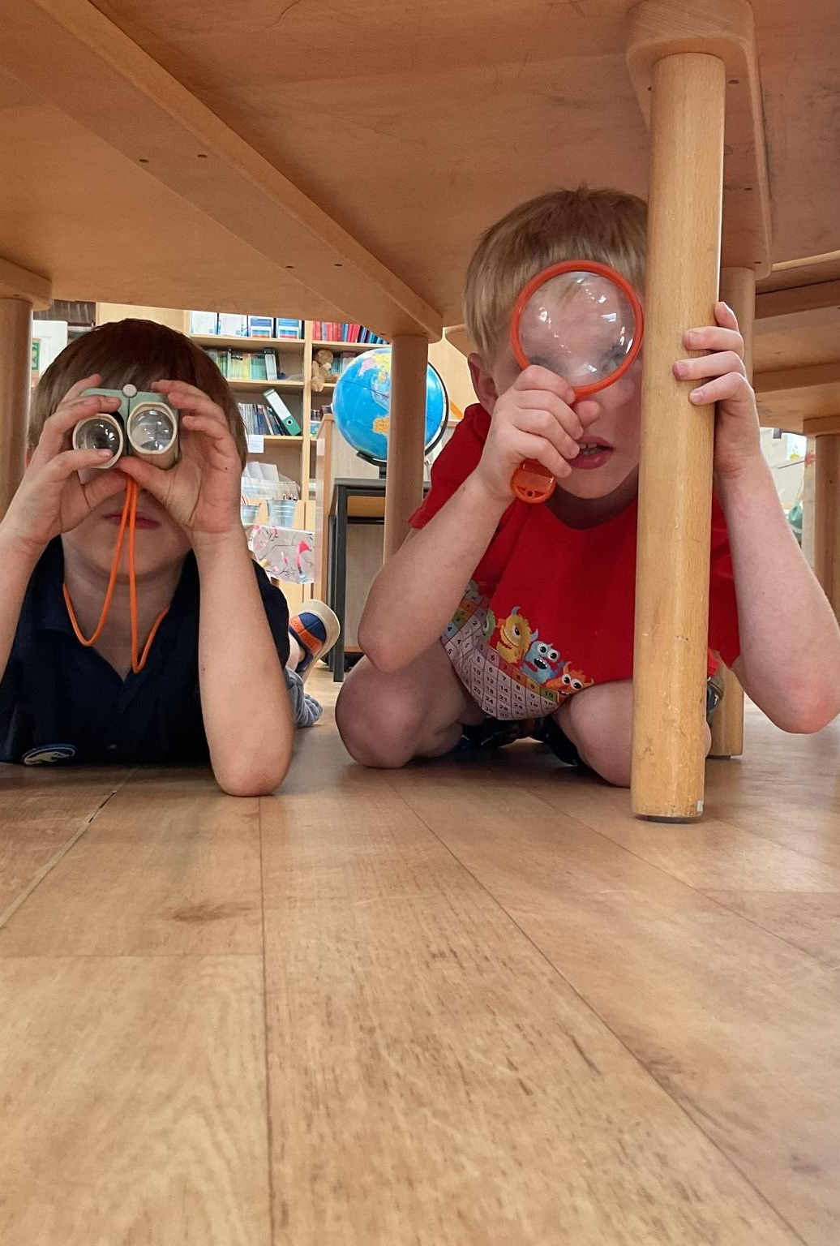
Key Dates
4th November 2026 – Primary Portal opens at 11am (Buckinghamshire Residents)
15th January 2027 – Primary Portal closes at Midnight
16th April 2027 – National Primary Allocation Day (Email)
30th April 2027 – Deadline for First Round Acceptances

Slide 16
The good news (for you)
https://www.ons.gov.uk/aboutus/transparencyandgovernance/freedomofinformationfoi/birthsanddeathsinwendoverandbuckinghamshire2012to2023

Slide 17

How do I pick a school?

Slide 18
Take some time to think…
Before you arrange any visits:
What is important to you?
What do you value from your child’s current setting?
But… what do you already do well at home?
(Does this need to be replicated at school, or would you like to have school cultivate other strengths?)

Slide 19
On a tour…
What’s the feel of the school?
Do your values align with the Head/wider staff?
What is engagement like?
Ask “Is this normal?” if you see something you like/don’t like.
Are there any events you could go along to? Stay and plays, Christmas Fayres etc. are a good indication of culture.

Slide 20

Getting your child ready…
Read, read, read! Children who love books excel at school.
Toilet training (including wiping). Help at: eric.org.uk
Independence: zips, buttons, washing and drying hands etc.
Speaking positively about school: not something to be feared
Asking open questions
Having predictable routines

Slide 21

Final tips and takeaways
Please please please put at least four options on the form
Look around as many places as you can
If something isn’t going to plan, speak to your local school, or to us

Slide 22


